Slide 1
QUERY OPTIMIZATION

Slide 2

CONTENTS
Introduction
Query Optimization in RDBMS
System-R optimizer
Starburst
Volcano/Cascades
Conclusion
References

Slide 3
INDRODUCTION

Slide 4

WHAT IS?
Query
Query
Simple
Complex
Dictionary Definition:
a question, especially one expressing doubt or requesting information.
Request for information from Database

Slide 5
Query Processing
List of activities performed to get the result
Activities include:
Parser & Translator
Optimizer
Evaluation Engine
Query
Query Processing
Result

Slide 6
Query Optimization
Query
Query Result
Function of many DBMS
Determines how to execute the query
Done by the Optimizer
Steps that lead to Optimization:
Query passed
Relational Algebra Expressions
Parser & Translator
Data
Relational Algebra Expressions
Execution Engine
Optimizer
Execution Plan
Statistics

Slide 7
Parser & Translator
Parser & Translator
Syntax:
Select eno from emp having enm=‘Pooja’;
ERROR 1054 (42S22): Unknown column 'enm' in 'having clause‘
Syntax
Schema Elements
+-------+-------------+------+-----+---------+-------+
| Field | Type | Null | Key | Default | Extra |
+-------+-------------+------+-----+---------+-------+
| eno | int(11) | NO | PRI | NULL | |
| enm | varchar(20) | YES | | NULL | |
| sal | double(9,2) | YES | | NULL | |
| dno | int(11) | YES | MUL | NULL | |
| mgr | int(11) | YES | | NULL | |
+-------+-------------+------+-----+---------+-------+
Schema Elements
select salary from emp;
ERROR 1054 (42S22): Unknown column 'salary' in 'field list'

Slide 8

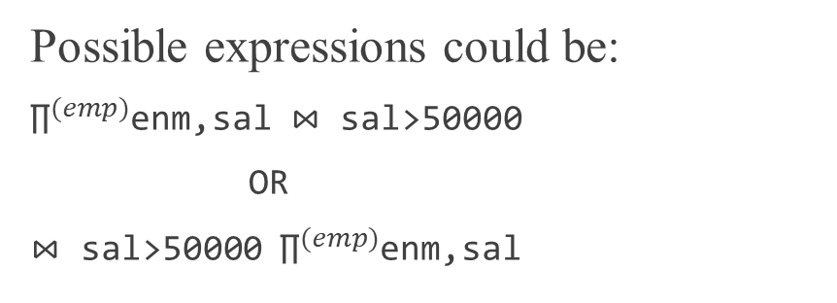
Optimizer
Possible expressions could be:
${\text{∏}}^{(emp)}$enm,sal ⋈ sal>50000
OR
⋈ sal>50000 ${\text{∏}}^{(emp)}$enm,sal
Evaluates Relational Algebra Expression
Its task is non-trivial
Finds the best plan to do so
Best plan with minimum cost
Creates the evaluation plan
Consider this statement:
Select enm,sal from emp where sal>50000;
Evaluation Plan
Query Tree
$\text{∏}$enm,sal
Use Algo C
Use Index A, Algo B
⋈ sal>50000
emp

Slide 9
Execution Engine
Implements a set of physical operators
Execution of the plan
Generate result
select enm,sal from emp where sal<10000;
+-------+---------+
| enm | sal |
+-------+---------+
| Pooja | 1000.00 |
| Sonal | 5000.00 |
+-------+---------+
Input
Operator
Output

Slide 10
QUERY OPTIMIZATION IN RDBMS

Slide 11
Operator: a piece of code (building blocks) that make execution of
SQL queries possible
Execution Plan is represented as an Operator Tree
Algebraic Representation can be transformed into as many logically equivalent representations, Say
Join(Join(A,B),C)=Join(Join(B,C),A)
Query optimization is a difficult search problem.
Optimizer is provided with:
A space of plans (search space)
A cost estimation technique
An enumeration algorithm
Goal of Optimizer

Slide 12
SYSTEM-R OPTIMIZER

Slide 13
significantly advanced the state of query optimization for relational
systems.
Search Space consists of operator trees
Consider, Join(Join(Join(A,B),C),D)
Join(C,D)
Join(B,C)
Join(B,C)
D
Join(A,B)
Join(C,D)
Join(A,B)
c
B
A
B
C
D
A

Slide 14





Optimal Plans:
Say,
Join({$R_{1},R_{2},R_{3}\},R_{4})$
Join({$R_{1},R_{3},R_{4}\},R_{2})$
Join({$R_{1},R_{2},R_{4}\},R_{3})$
Join({$R_{2},R_{3},R_{4}\},R_{1})$
A
B
C
D
$$R_{1}$$
$$R_{2}$$
$$R_{3}$$
$$R_{4}$$
Best Plan

Slide 15
Cost Model
Assigns an estimated cost to a plan
Estimates the size of every output data stream for every operator
Measures of Query Cost
Disk Accesses
CPU Cycles
Transit Time
Computes this information in bottom up manner
Associates information with,
Size of Data Stream
Ordering of Tuples
Execution cost for operator

Slide 16
Statistics and Cost Estimation
Collect statistical summaries of data that has been stored.
Given an operator and the statistical summary for each of its input data streams, determine the:
Statistical summary of the output data stream
Estimated cost of executing the operation
Cost Estimation must be efficient

Slide 17
STARBURST

Slide 18
Created at the IBM Almaden Research Center
Applies rules in forward chaining manner
Query Graph Model (QGM)
Box → query block
Labelled arcs → table references
Follows these steps:
Query Rewrite Phase
Plan Optimization
Own Language Design:
syntax for creating (as well as modifying, deleting, and grouping) rules
semantics of rule processing at run time.
Uses dynamic programming in bottom-up manner

Slide 19
VOLCANO/CASCADES

Slide 20
Evolved from Exodus
Two types of rules are used:
Transformation Rules → map algebraic expression to another
Implementation Rules → map algebraic expressions to an operator tree
Uses dynamic programming in top-down manner
Differs from Starburst:
Doesn’t use 2 phases
Mapping expressions to operators need single step
Goal-driven application of rules
Volcano optimizer has been used to develop optimizers for computations over scientific databases and for Texas Instruments' Open OODB project

Slide 21
CONCLUSION

Slide 22
Optimization is much more than evaluation plans
Designing an effective and robust optimizer is challenging
Significant open problems remain like:
Considering memory in cost estimation
Fuzzy queries
Generation of complete plans subject to availability of runtime information

Slide 23
REFERENCES
Chaudhuri, S.. Krishnamurthy. R., Potamianos. S., Shim K. “Optimizing Queries with Materialized Views”. In Proc. of IEEE Data Engineering Conference, Taipei. 1995.
Chaudhuri, S.. Krishnamurthy. R., Potamianos. S., Shim K. “Query Optimization in Relational Systems”, Microsoft Research, One Microsoft Way, Redmond. 1998.
J.Hellerstein, “Query Optimization, Readings in Database Systems”, 5th Edition, 2015
G.Graefe, W.J.Mckenna, “The Volcano Optimizer Generator: Extensibility and Efficient Search”, . In Proc. of IEEE Data Engineering Conference, Boulder. 1993.

Slide 24
THANK YOU

